Slide 1
HPC Project Report
POLITECNICO DI TORINO
MSc in Quantum Engineering
01HEKYU — High Performance Computing
Leonardo Antonio Riola
Davide Donati
Giacomo Girotto
353851
352165
361610
Academic Year 2025/2026
September 2026

Slide 2

Assignment 1: Damped Wave Simulation with OpenMP
Simulation parallelized with OpenMP on HPC@PoliTO
(Partitions used: edu_skylake, edu_sapphire)

Slide 3
Initial Implementation
Numerical setting
Central differences on a regular Δx, Δy, Δt grid
u_past, u, u_fut matrices hold t−1, t and t+1 values
Zero everywhere except one impulse at the centre
Pointer rotation for time advancing
OpenMP structure
One parallel region opened before the time loop
collapse(2) fuses i and j loops into one M×M space
Each thread owns a disjoint set of coordinates
Writing PGM file and pointer rotation perfomed by single thread
Per-timestep sequence
stencil calculation
(omp for, collapse(2))
scale into
pixel buffer
one fwrite per pixel
(omp single)
rotate
u_past / u / u_fut
(omp single)
VTune Hotspots analysis at M=1000 on 32 threads
79.4% of CPU time in gomp_team_barrier_wait_end, 9.7% in fwrite, 2.2% in the matrix calculation.

Slide 4
Code Optimization on Edu_skylake partition
1. Buffered frame output
Per pixel fwrite replaced by one in-memory buffer, filled in parallel and flushed with a single call per frame.
However, a new barrier is introduced.
2. Loop fusion
Stencil and buffer-fill were merged into the same omp for directive, removing the added barrier.
3. Parallel initialization and (guided) schedule
Matrices initialization parallelized with the same stencil's schedule (guided)
57.5%
barrier wait, from 79.4%
15.7%
stencil, from 2.2%
<0.3%
fwrite, from 9.7%
Threading analysis still reported 23% effective CPU utilization. Evidently, at M=1000 the workload was too small for the team size.
Moving to different HPC settings for changing the hardware utilization.

Slide 5
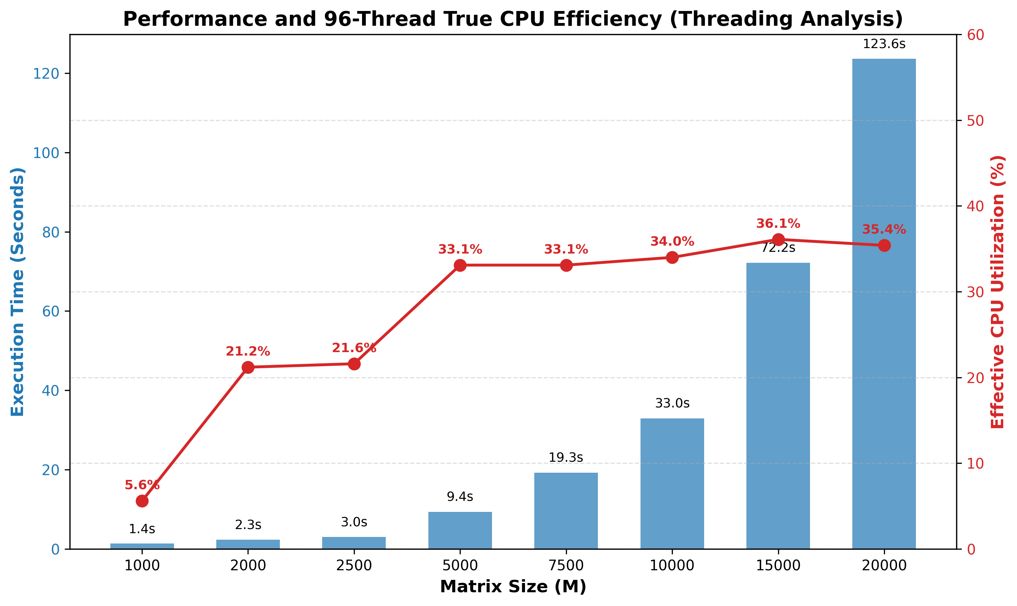
Sweep of workload size (M) on Edu_sapphire partition
Hardware specs: 48 physical and 96 logical cores, dual-socket with 24 physical cores per socket
CPU utilization trend
From M=1000 to M=2500 : thread starvation
From M=5000 to M=15000 : computational load outweight the fixed overheads
From M≥15000 : plateau due to I/O and memory bottleneck
Execution times trend
Validation of the theoretical O(M^2) complexity for larger grids.
Fixed overheads times dominate for smaller grids.

Slide 6
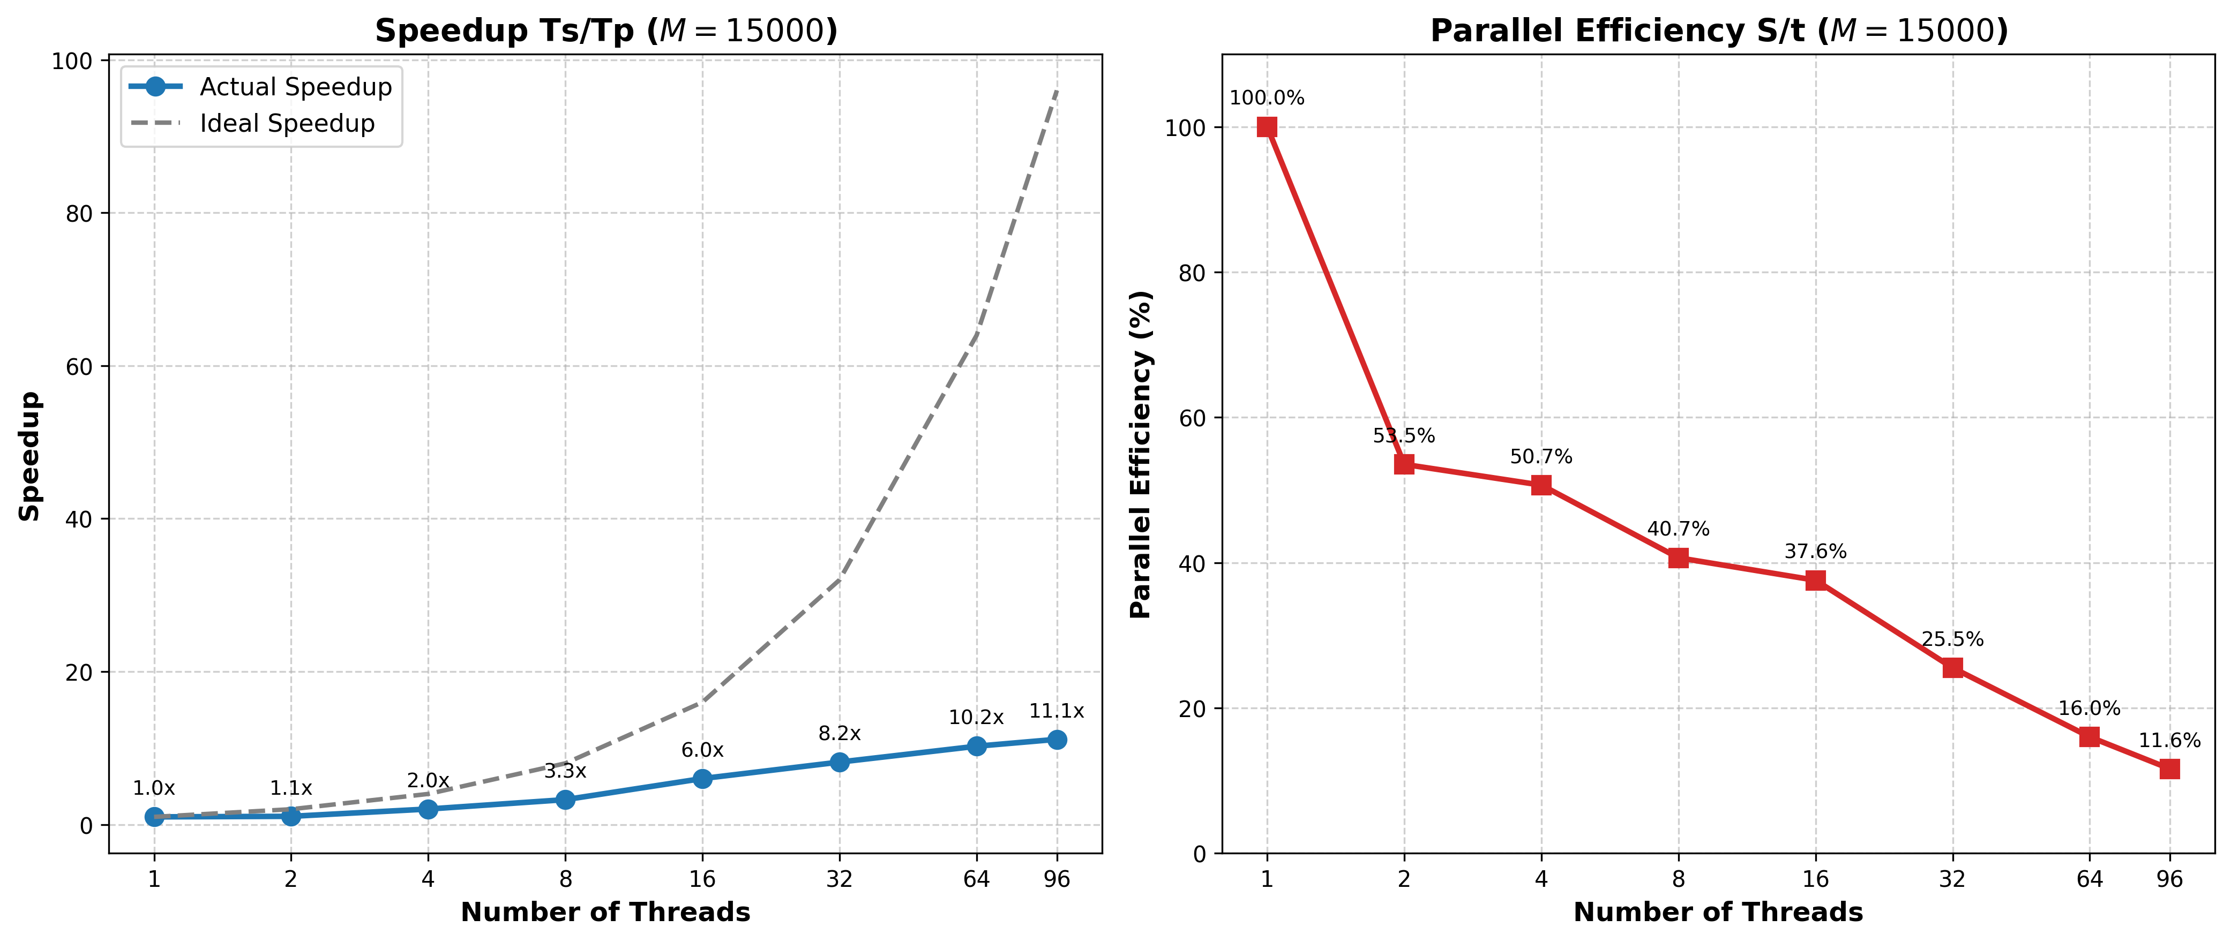
Sweep of number of threads with M=15000
Speed up very far away from ideal (11.1x with 96 threads)
Discending trend for parallel efficiency, with significant drop when t≥32 (NUMA architecture).
For t=64 and t=96 Hyper-Threading is used, contributing to efficiency decrease.

Slide 7
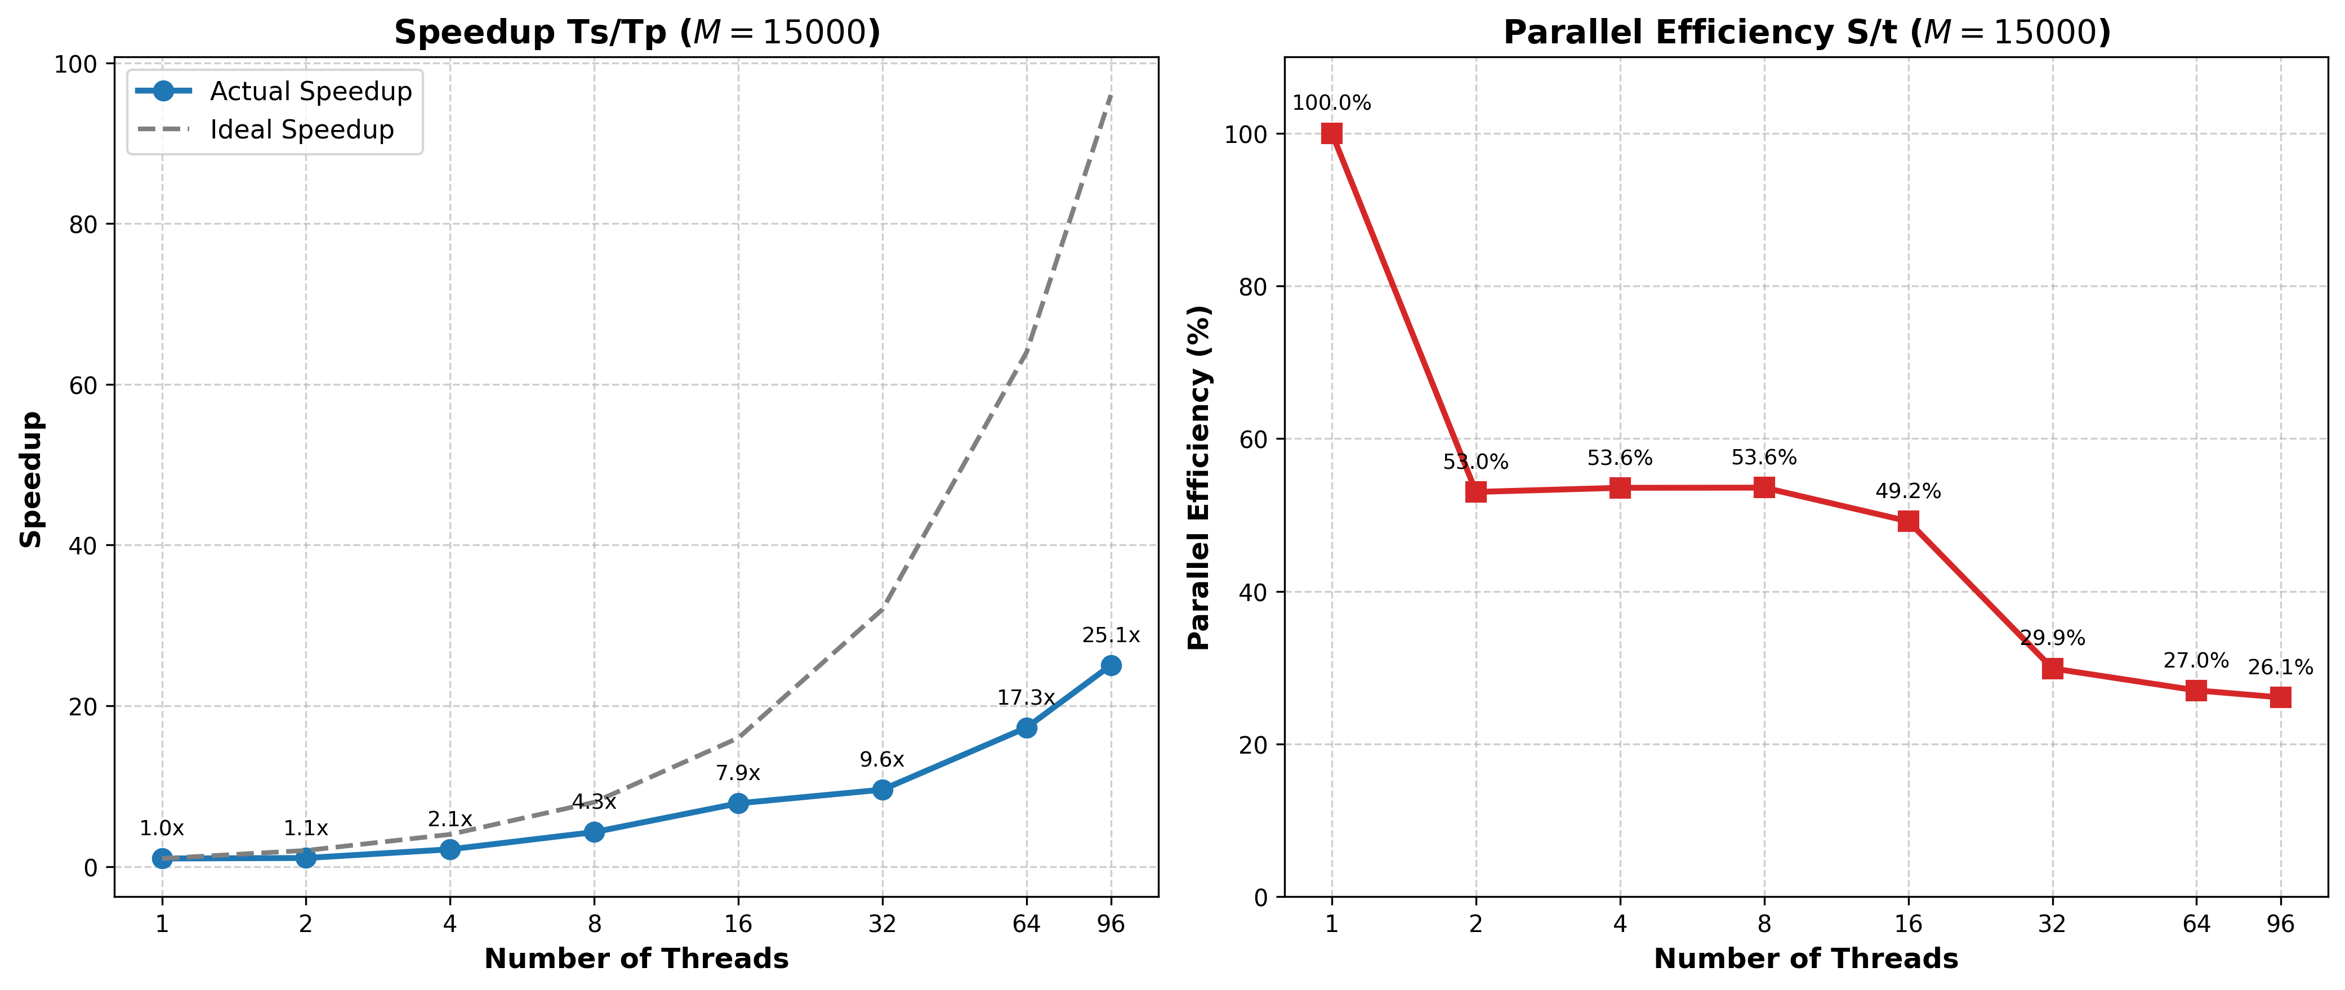
Sweep of number of threads without I/O
Maximum speedup doubled: from 11.6x to 25.1x
Parallel efficiency raised up: maximum at 26.1%
Huge drop when both sockets are used: schedule(guided)

Slide 8
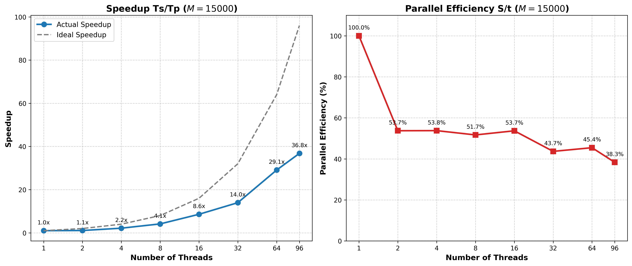
Sweep of threads without I/O with schedule(static)
Drop drastically reduced (spatial locality).
Maximum speed-up and parallel efficiency increased up to 36.8x and 38.3%.

Slide 9

Assignment 2 — Hybrid MPI + OpenMP
Multi-wave interference on HPC@PoliTO
Finding: the ceiling is disk I/O and socket-level memory contention — not the stencil

Slide 10
3 MPI ranks, one scenario each, OpenMP inside each
The three ranks never exchange data, each runs its own full simulation loop independently.
Rank 0
Baseline single wave
Reproduces the single-wave reference run from Assignment 1, unchanged.
Rank 1
Two impulses at t = 0
Both impulses released together, so the interference pattern forms immediately.
Rank 2
Second impulse at t_start
The second impulse is delayed, giving time-shifted interference instead.
With no cross-rank coordination cost, memory allocation and thread synchronization are tuned per rank. MPI_Finalize is the only synchronization point in the program.

Slide 11
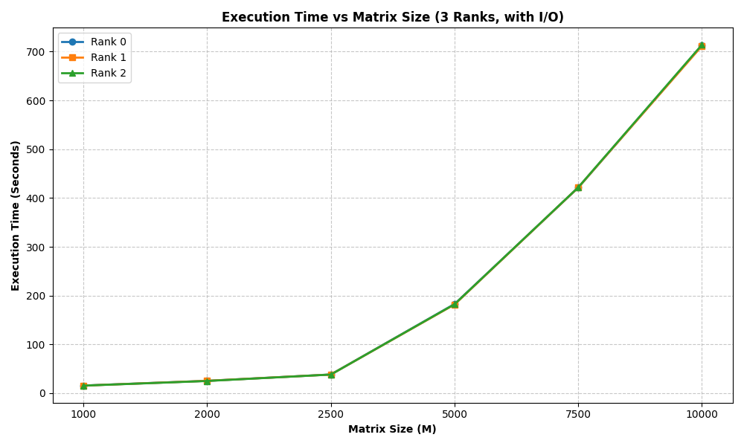
Concurrent disk writes icreases the execution time
Execution time of each three ranks with 8 thread each, with I/O. Growth is far steeper than the single rank Assignment 1 run: all three ranks write their frames to the same shared filesystem at the same time.

Slide 12
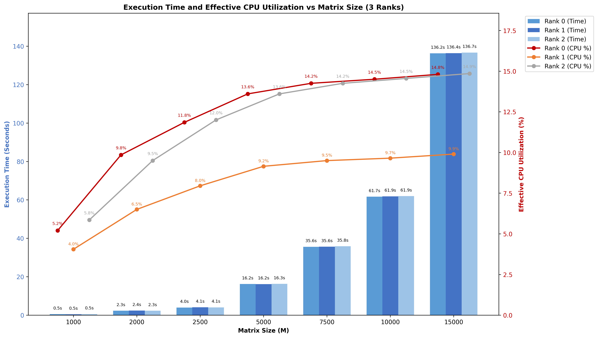
Removing I/O: 700s → 61s at M=10000 but Rank 1's ?
While execution times are perfectly balanced across all three ranks, confirming equal computational workload, the effective CPU utilization shows a distinct asymmetry. Specifically, Rank 1 exhibits lower efficiency compared to Ranks 0 and 2, which motivates our investigation into socket-level memory interference and thread pinning.

Slide 13
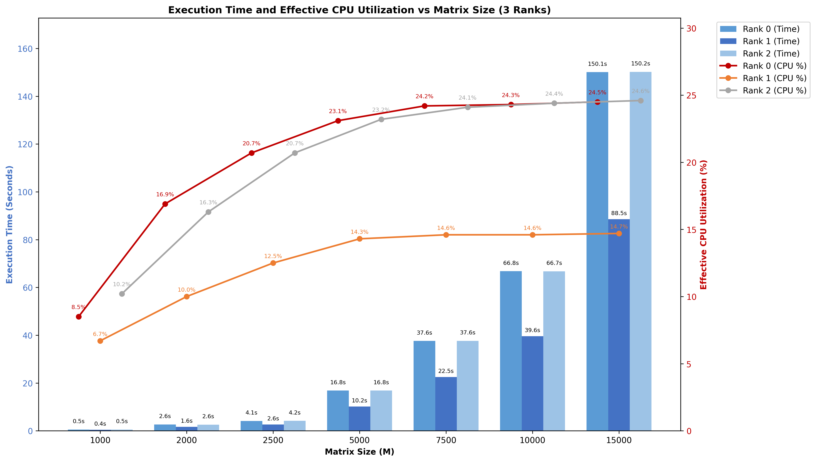
Isolating Rank 1 on a Separate Socket: 88s vs 150s
Placing Rank 1 on its own socket resolves the memory contention, making it finish significantly faster. Because \textbf{MPI_Finalize} acts as a global barrier, Rank 1 idles while waiting for the others, which drags down its recorded VTune CPU utilization score.

Slide 14
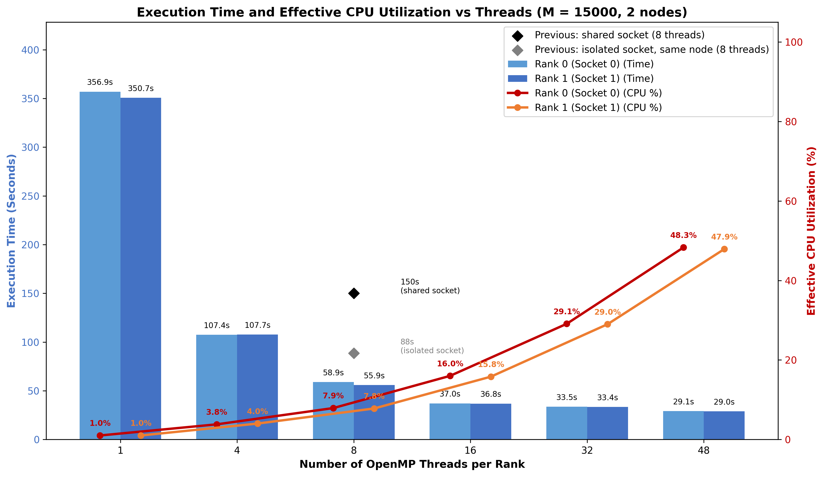
One dedicated node per rank drops time to ~57s (at 8 threads) and achieves a best of ~29s at 48 threads
Isolating each simulation on separate nodes eliminates memory contention, while both ranks show perfectly balanced performance confirming previous asymmetries were due to waiting times.

Slide 15
Conclusions
The real bottleneck is concurrent disk I/O: Bypassing simultaneous disk I/O bottlenecks transformed the application's scaling, slashing execution time from ~700s down to 61s at $M=10000$.
Socket-level memory contention is measurable. Rank 1 alone on a socket finished in 88s against 150s for the two ranks sharing the other.
The low utilization was an artifact, not wasted compute. MPI_Finalize idle time drags down the score of the fastest rank, a conclusion only the two experiments together support.
Best configuration: one dedicated node per rank, 48 OpenMP threads — about 29s at M=15000, with CPU utilization at 48%.

Slide 16

Colorized Wave Simulation on GPU
Assignment 3 — MPI + OpenMP + CUDA
Profiled on HPC@PoliTO (Legion), edu_a40 and edu_v100
Finding: the bottleneck is file I/O, not compute

Slide 17
Three independent scenarios, one shared GPU
Per-rank pipeline
3 MPI ranks, one scenario each: a single impulse; two impulses starting together; two impulses with the second delayed to N/ 7
OpenMP 5-point Laplacian stencil
CUDA kernel maps each value to RGB
Per-frame adaptive colour scale
ASCII P3 PPM frame written each step
Cluster: HPC@PoliTO (Legion)
edu_a40 — 2x24 cores + SMT, 4x A40
edu_v100 — 32 cores, 4x V100
Job requests --gres=gpu:1
All three ranks share one GPU
Nsight Compute blocked: ERR_NVGPUCTRPERM
Per-frame output path
compute_next
(OpenMP)
H2D copy
colorize
kernel
D2H copy
ASCII format
disk write
(fwrite)
These last two carry ~99% of the frame cost

Slide 18
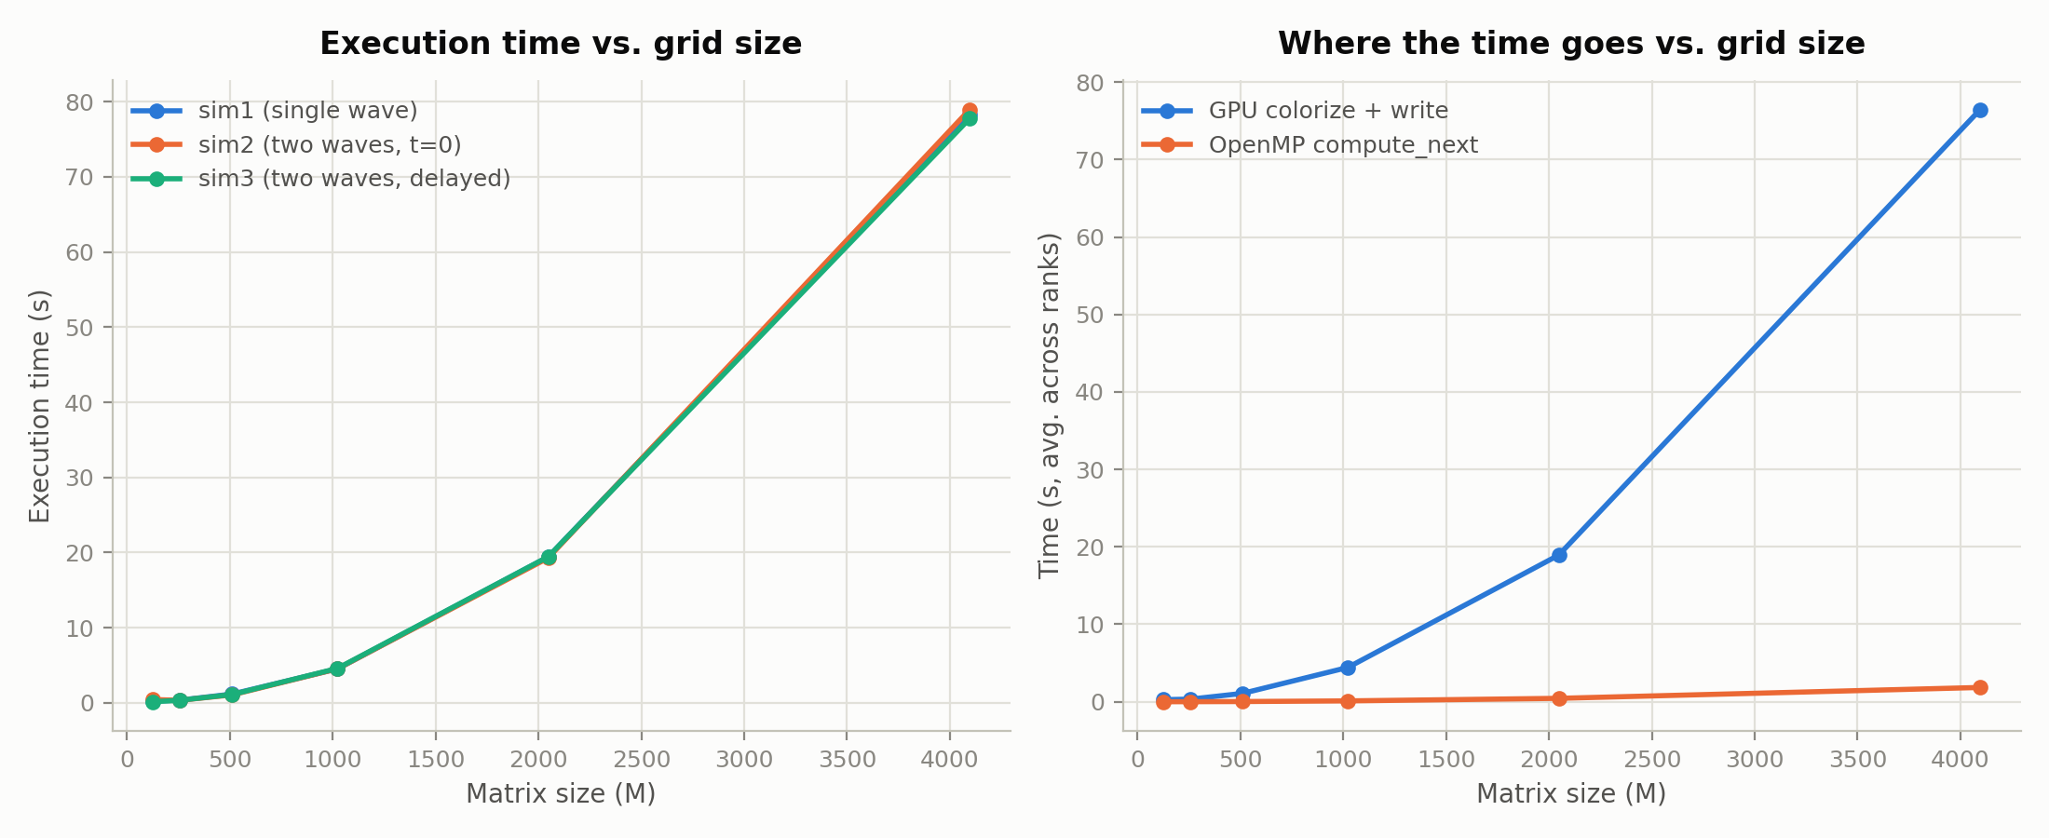
Near-ideal O(M²) scaling — and GPU colorize+write dominates throughout
128 → 256 costs only 2.1×, 2048 → 4096 costs 4.1× (ideal quadratic). At M=4096, GPU colorize+write is ~97.6% of total time; compute_next ~2.4%.
Sweep capped at M=4096: an ASCII PPM frame is already ~100–130MB there, so M=15000 would mean multi-gigabyte frames across 50 steps and 3 ranks.

Slide 19
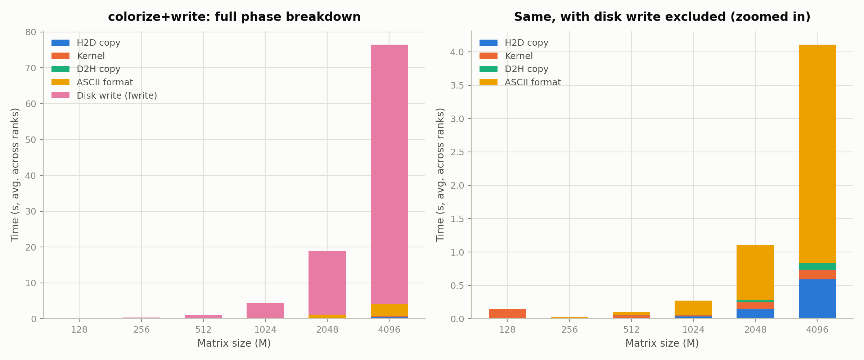
The disk write is 94.6% of the frame cost
At M=4096: write ~94.6%, ASCII format ~4.3%, H2D+kernel+D2H ~1% combined — so parallelizing the ASCII formatting was measured, then rejected.

Slide 20
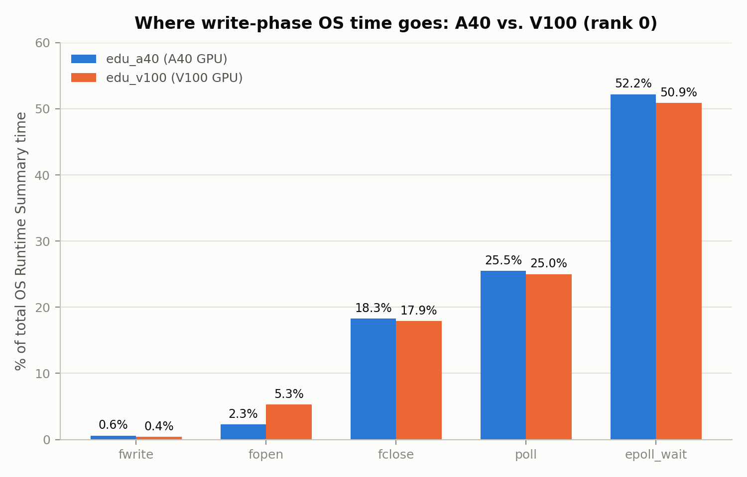
It isn't fwrite — it's fclose, on both GPU generations
Nsight Systems OS Runtime Summary, rank 0. fclose ~18% vs. fwrite ~0.6% — roughly 30× the call it follows.
Profile is near-identical on A40 and V100, so the bottleneck is I/O and synchronization, not GPU hardware.
Despite this near-identical OS-runtime split, the whole production run was about 3× slower end-to-end on V100 — consistent with H2D transfer time rising from ~52% to ~67% of GPU time on the older card.
18.3%
fclose
0.6%
fwrite
epoll_wait ~52% + poll ~25%: a follow-up MPI trace ruled out application-level MPI — Allreduce itself is 13.7ms, under 2% of that time. More likely OpenMPI’s UCX/InfiniBand transport layer idling in the background.

Slide 21
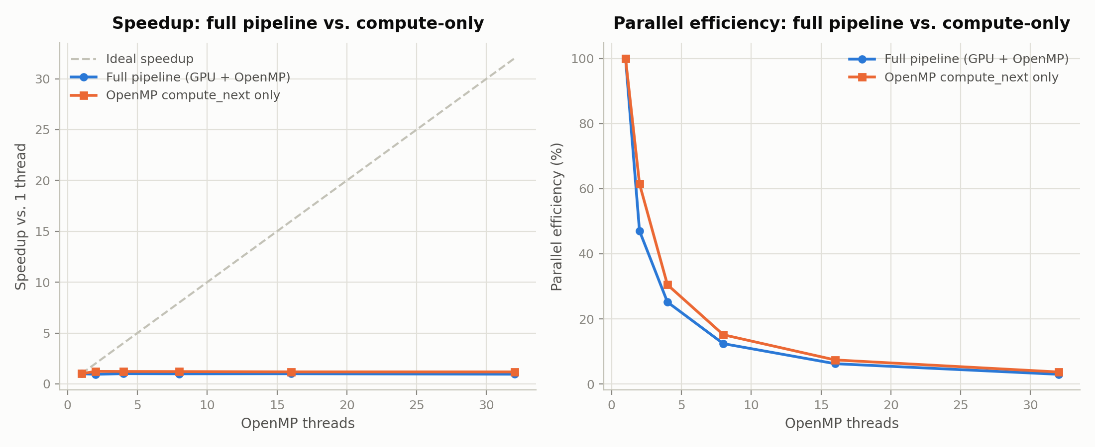
Threads buy nothing: flat from 1 to 32 threads
M=4096: both curves flat, never above ~1.2×; compute-only plateaus by 2 threads. VTune confirms it’s bandwidth, not fork/join overhead: no barrier hotspot at either thread count, and compute_next’s own cost stays flat (3.43s to 3.21s) from 4 to 32 threads.

Slide 22
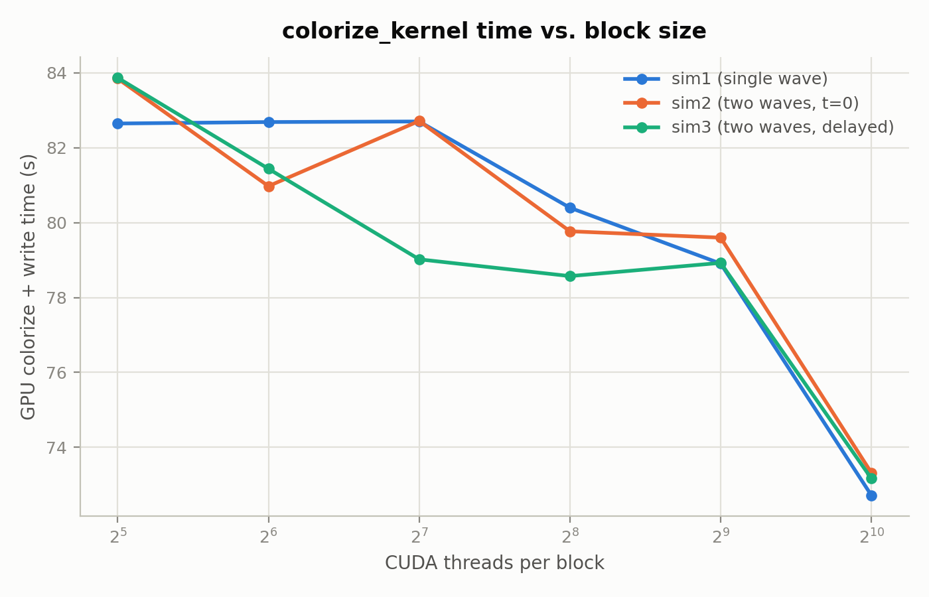
Bigger CUDA blocks win: ~12% from 32 to 1024 threads
M=4096, GPU colorize + write time.
Time falls roughly monotonically with block size: ~83s at 32 threads/block down to ~73s at 1024, with a minor plateau between 128 and 512.
Not independently confirmed: a noisier earlier sweep at M=1024 trended the other way at the high end, and Nsight Compute is blocked, so there is no occupancy-level explanation.
~83s
32 threads/block
~73s
1024 threads/block

Slide 23
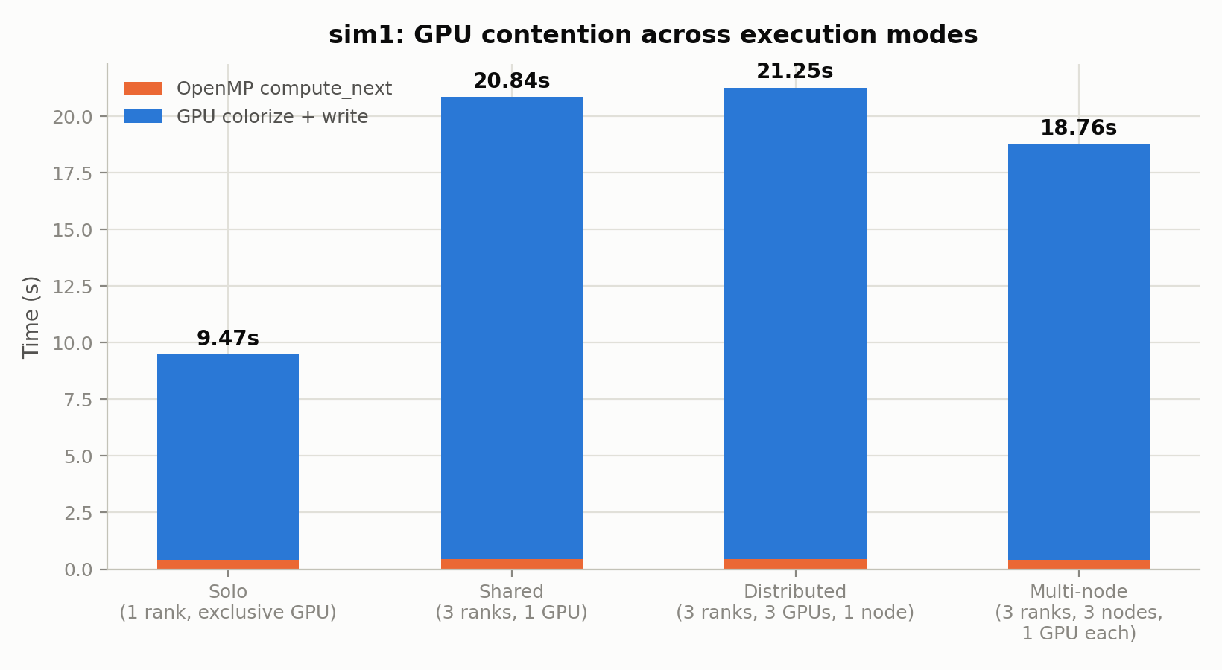
Sharing the GPU is free; sharing the filesystem is not
M=2048, 50 steps, 4 threads — sim1's workload isolated in each mode.
Dedicating a GPU per rank changes nothing: distributed (21.25s) is ~2% slower than shared (20.84s), within noise. Solo is ~50% faster because it is the only mode with a single writer. Multi-node (18.76s) removes host-local contention but still writes to the same shared filesystem.
9.47s
solo, one writer
20.84s
3 concurrent writers

Slide 24
Measure first, then optimize
I/O dominates. Colorization kernel ~1% of frame time, compute_next ~2% — the cost is per-frame file I/O, concentrated at fclose.
Confirmed across hardware. The OS-runtime profile is near-identical on A40 and V100, so it is not GPU-specific.
ASCII formatting: rejected. At ~4% of color_time, parallelizing it could not repay the added complexity.
Adaptive colour scale: adopted. Raw pixel data showed a fixed scale goes pale almost immediately.
Contention is filesystem, not GPU. Four execution modes settled it by measurement, not by spec sheet.
Every optimization decision here was made after measuring — none assumed from the physics or the spec sheet.

Slide 25
Conclusions
Assignment 1 — OpenMP. Speedup stalls at 11.1x on 96 threads with I/O; removing the writes and using schedule(static) lifts it to 36.8x.
Assignment 2 — Hybrid MPI + OpenMP. The ceiling is disk I/O and socket-level memory contention, not the stencil.
Assignment 3 — CUDA. The disk write is 94.6% of the frame cost; the colorization kernel is ~1%.
Across all three, the limiting resource was the filesystem — every decision was made from measurements, not from the spec sheet.
Thank you for your attention — questions are welcome

